Slide 1
Financial Impact of External Review
Dr. Laura Chesson – Superintendent of Schools
Michael Knight - Director of Business and Finance
October 25, 2017

Slide 2
Information Gathering
Custodial Out-sourcing – met with Director of Buildings and Grounds and principals. One principal out of 5 had no concerns regarding current level of support.
Food Service Out-sourcing - met with Director of Food Service, several principals, superintendents of three districts that had out sourced. Principals and superintendents who had experience with out-sourcing reported very positive experiences.
Transportation Reconfiguration – met with Massachusetts Association of Regional School District (MARS) superintendents and Jay Sullivan from DESE. Members of business office staff met with Dee Bus and also observed actual ridership at all levels.
Relocation of Central Office – met with staff at Boutwell, GDRHS, and GDRMS (5th, 6th, and open meeting).

Slide 3
Custodial Privatization
Potential Savings: $205,204.68
The current cost for custodian Salaries and Benefits is $975,980.68
A proposal from a privatization firm listed the cost as $770,776.00
This would indicate a savings of $205,204.68, most of this can be attributed to the savings in benefits.
This savings model includes reducing to a single day custodian at the middle school buildings per the recommendation of the Abrahams reports but if we wished to add one the cost would be $41,000.

Slide 4
Custodial Additional Considerations
This quick financial analysis does not include savings that would be realized in cleaning supplies (roughly $15,000), assessment from Middlesex County Retirement system, and Worker’s Compensation insurance.
When considering this model it is important to note that in the first year and a half we could see a significant rise in unemployment. The privatization firms work to keep current employees but in the unlikely scenario that all employees remained unemployed there could be significant costs. If all employees were to file we could see this as high as $389,140 in the first year and $194,569.93 in the second year.

Slide 5
Recommendation
Continue to explore for fy20 due to high probability of some unemployment claims.
Explore possibility of phasing in school by school in order to limit unemployment claims.

Slide 6
Food Service Privatization
Potential Saving: $179,897
Currently the food service department runs a deficit of $179,897 if all benefits costs are billed to the department.
A privatization firm estimates that they can reduce costs and increase profitability and participation such that the food service department will be self sustaining. Cost reduction accounting for $53,000 and profitability increases accounting for $130,000
The main drivers for the increases in participation in profitability would be increasing meal and al a carte offerings.
There are additional potential savings from food costs that were more difficult to estimate but could bring an additional cost savings of as much as 5% ($10,000).
As is the case with all privatization, the impact of unemployment needs to be considered. The costs could be as high as $193,466.73 for the first year and $96,733.36 for the second year. The vendor who I worked the numbers with let me know this is unlikely as they generally retain over 70% of the employees.

Slide 7
Recommendation
Continue to explore out-sourcing food service for fy19.
Seek additional proposals as is required by regulations.
Select best proposal for school committee approval by early 2018.

Slide 8
Transportation Option A
Potential Savings: $55,800
The district is currently and continuously looking at software or consultants that can help us more effectively prepare our routes with the goal of increasing our ridership %. Looking at the school with the highest ridership numbers if we were to take the total student population and book the buses at 100% capacity we would be able to reduce 3 buses. Reducing a single bus on a 2 run schedule would result in a cost savings of $62,000 ($18,600 after reimbursement is backed out).
We still need to plan this out to see what the impact to walking distance and rider time will be. This information will be coming at a future meeting to address the actual feasibility of this plan.

Slide 9
Transportation Option B
Savings up to: $ 75,400
There is also the potential that we charge a bus fee for those inside the 1.5 mile reimbursable radius. There are 377 students who live within the 1.5 miles of their school. If we were to charge a $200.00 fee for these students to ride we could raise as much as $75,400. This is a maximum benefit and I imagine we would find most of those that were assessed a bus fee would chose to drive or walk to school which could result in a reduction of the buses needed and cost savings associated with the reduction in the number of buses. Reducing a single bus on a 2 run schedule would result in a cost savings of $62,000 ($18,600 after reimbursement is backed out).

Slide 10
Transportation Option C
Savings: $ 15,692
If the district were to move the High School start time back it is possible that we would be able to switch to 2 bus runs a day. Assuming the same number of buses was used and ridership was higher on these buses this would save the district $52,309.00 ($15,692 after a 70% reimbursement is taken into account) based on this year’s contract pricing.
This plan would require a greater amount of time examining the routes and changes to ridership time that would occur from the switch as well as if there are ways to keep ridership times similar by combining bus stops and increasing walking distance to stops.

Slide 11
Recommendation
Reduce high school bus runs for fy 2018.
Reduce to two bus runs for fy 2019.
Implement bus fee for fy 2019.
Arrange for assistance with designing most effective bus runs and reduce number of buses wherever possible to ensure meeting 75% assigned ridership required to receive reimbursement.

Slide 12
Facilities Move From Prescott
Potential Savings: Year 1 $(18,908.86)
Potential Savings: Year 2 $31,591.14
Potential Savings: Year 3 $43,591.14
Potential Savings Beyond : 51,591.14
The savings from moving out of the Prescott school to another district owned building is $ 51,591.14 based on an average of the last 5 years of expenses associated with utilities and maintenance of the building. This savings does not take into account any rent or work/payment in lieu of rent that may be charged by the new building lessor.
The year one costs associated with moving out of the space and creating a new central office location in Middle School South would be a conservatively estimated $70,500.
The cost in year 2 of the move would be $20,000 and in year three only $8,000. Beyond year 3 we do not anticipate costs associated with the move to cost the district any more than the operation of the school cost in the past.

Slide 13
Options For Relocation
Move central office to high school lower level Wing D.
Move central office to Boutwell and move Boutwell to high school lower level Wing D.
Move central office to south campus middle school.

Slide 14
Option One Central Office Move to GDRHS
PROS:
Savings on all Prescott expenses
Central Office moved to district owned building.
Central Office located in building with students.
CONS:
High school will lose access to six classrooms and a teacher prep room.
Significant costs to retro-fit two regular classrooms to science labs.
Two retro-fitted lab would be below MSBA recommendations of 1200 sq. ft.
No cellular service inside high school. Could be problematic during emergency.

Slide 15
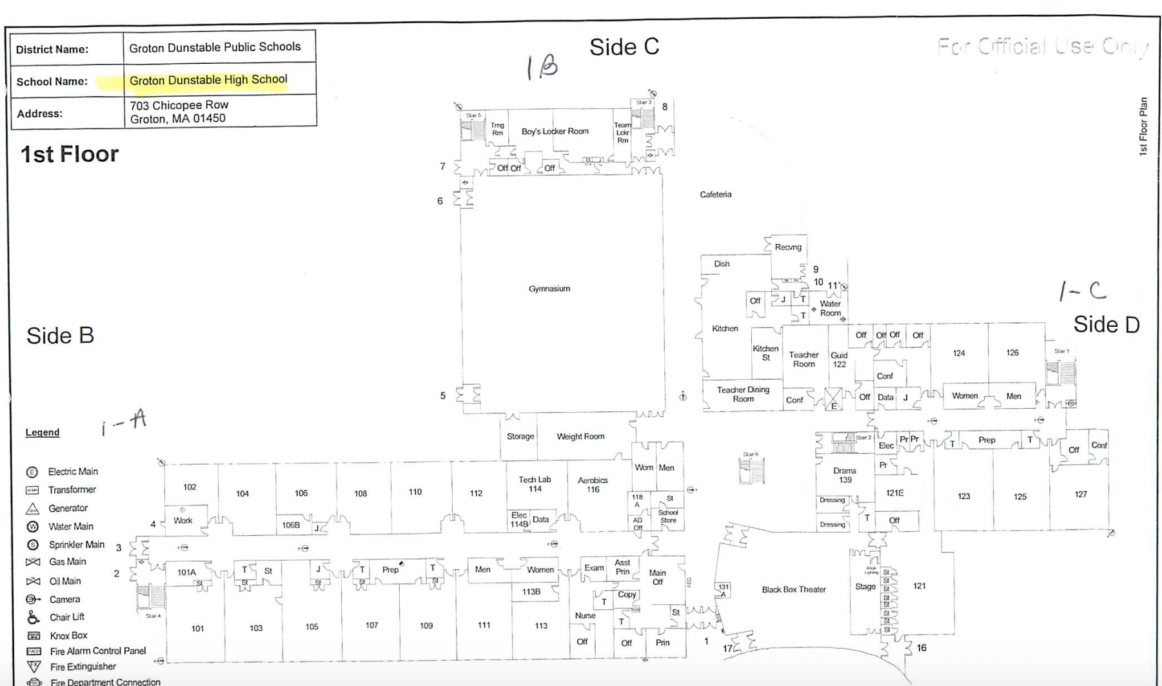

Slide 16
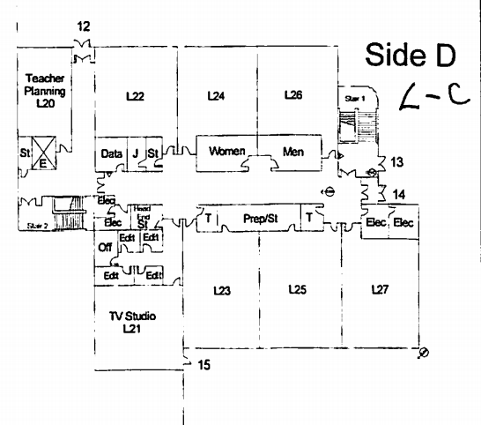
NEW SECURITY DOOR
NEW SECURITY DOOR

Slide 17
Options Tw0 – Central Office to Boutwell, Boutwell to GDRHS
PROS:
Savings on all Prescott expenses
Central Office moved to district owned building.
Ability to offer programs connecting high school to ECC.
CONS:
High school will lose access to six classrooms and a teacher prep room.
Significant costs to retro-fit two regular classrooms to science labs.
Two retro-fitted lab would be below MSBA recommendations of 1200 sq. ft.
Additional one-time costs to create special needs, age appropriate playground.
Additional one-time costs to retro-fit bathrooms for very young students.

Slide 18
NEW SECURITY DOOR
NEW SECURITY DOOR

Slide 19
Options Three – Central Office to Middle School South into Portables and Portions of Reconfigured Library.
PROS:
Savings on all Prescott expenses
Central Office moved to district owned building.
Central Office moved to building with students.
No teachers will lose classroom.
No students relocated.
Fiction and literature libraries moved back into classrooms to allow for closer proximity to students.
Costs for relocation will include upgrading computer lab in Middle School South, Maker Space in Middle School North, and conference rooms space off of current south library.
All library staff will remain.
CONS:
Some cost to re-align library resources in middle school south.

Slide 20
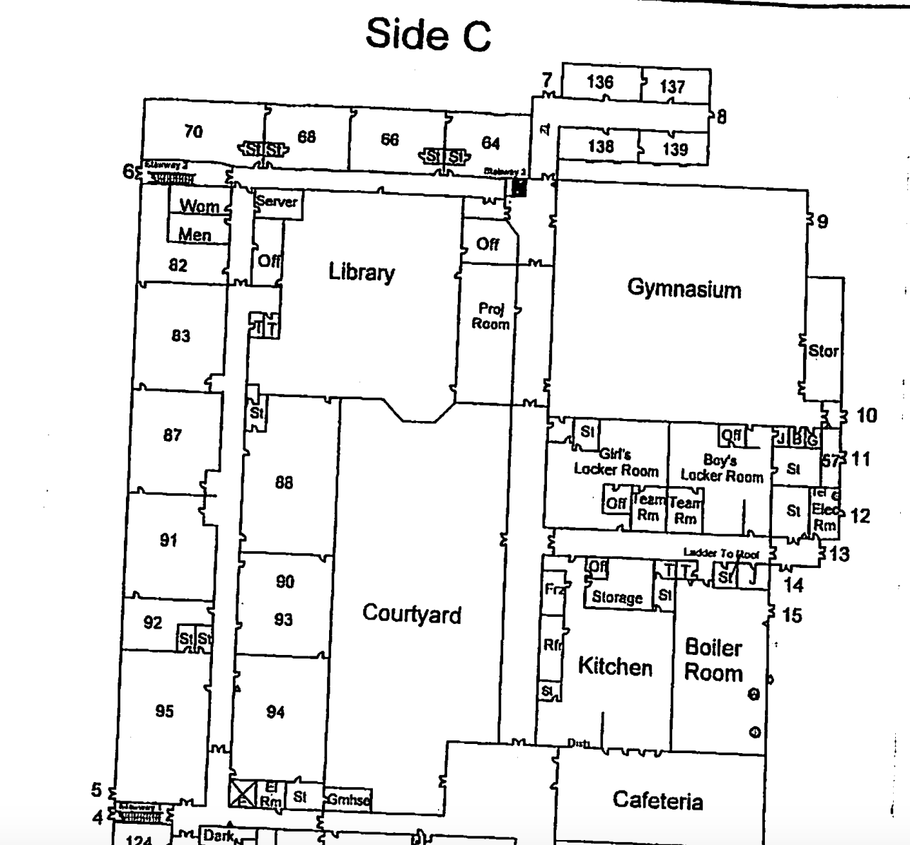

Slide 21
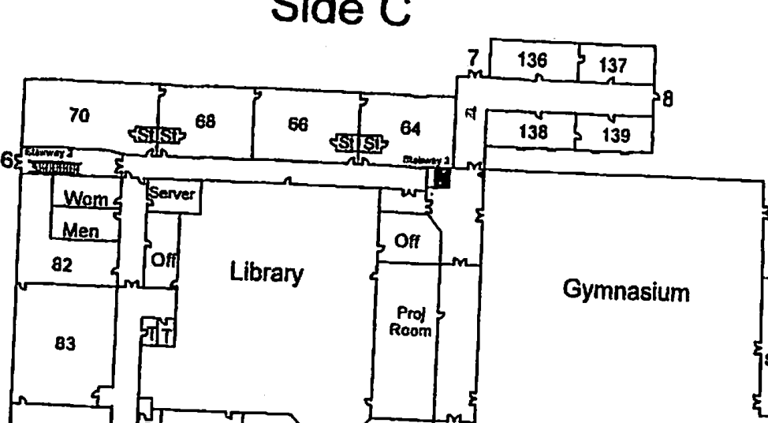
CENTRAL OFFICE SPACE
NON-FICTION
ADD NEW DOORWAY HERE
CENTRAL OFFICE SPACE

Slide 22
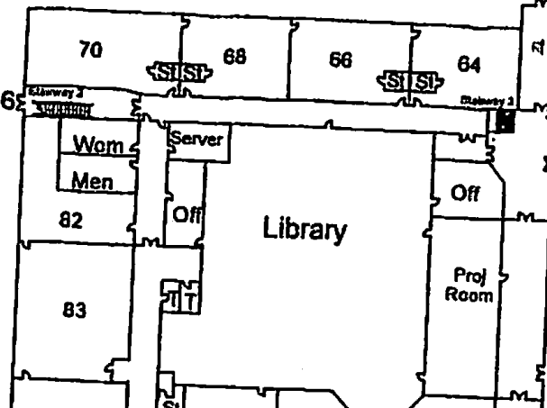
NON-FICTION
O
ENTRANCE
ADMIN ASSISTANTS
OFF
CONF. ROOM
SPED RECORDS
OFF

Slide 23
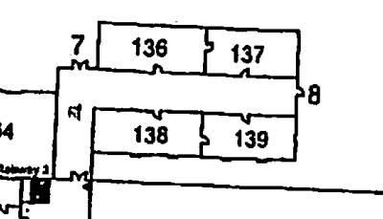
BLDGS & GROUNDS
CURR. DIRECTORS
BUSINESS OFFICE
CURR/HR
ADMIN ASST.
TECHNOLOGY

Slide 24
Recommendation
Move central office to Middle School south.
Highest cost savings vs. cost to implement.
No teacher will lose room
Minimal impact to students
Central office increased proximity to students and teachers
Central office in district owned building
Full utilization of portables not able to be used as classroom space.

Slide 25
Questions?

