Slide 1
Next Generation MCAS and Groton-Dunstable Results
Gr. 3 -8
October 2017

Slide 2
Contents
What is the next-generation MCAS?....... 3
Score release……………………………………. 6
Parent reports…………………………………... 9
Projected statewide results…………………. 12
Beyond scores…………………………………… 17
Accountability……………………………………. 18
Learning more…………………………………… 19

Slide 3
What is the Next-Generation MCAS?
Updated version of the nearly 20-year-old MCAS assessment
Focuses on students’ critical thinking abilities, application of knowledge, and ability to make connections between reading and writing
Gives a clearer signal of readiness for the next grade level or college and career
Designed to be given on a computer (though paper versions remain available)
First given in spring 2017 in grades 3-8 in English language arts and math
Will eventually replace all older (“legacy”) MCAS tests in grades 3-10

Slide 4

Computer-Based Testing
Spring 2017:
  60% of all grades 3-8 students took the test on computers; >93% in grades 4 and 8
Phasing in computer-based testing by grade level
  Spring 2017: Grades 4 and 8 English language arts (ELA) and math
  Spring 2018: Grades 4-5 and 7-8 in ELA and math and grades 5 and 8 in science and tech/eng
  Spring 2019: All tests in grades 3-8, grade 10 ELA and math

Slide 5



Equating of Computer- and Paper-Based Test Forms
Ensure fairness regardless of test form (computer or paper)
Applied in grades where schools could choose to administer computer-based or paper-based tests (grades 3, 5, 6, and 7)
Used the results from parts of the test that are similar to help adjust the scoring on parts of the test that vary by format.

Slide 6
Scores Are Being Released This Month for Tests Students Took in Spring 2017
Next-Gen MCAS
  English language arts and math, grades 3-8
Legacy MCAS
  Science and tech/eng in grades 5 and 8
  All high school MCAS (English language arts, math, and science and tech/eng)

Slide 7
What will the scores look like?
Achievement levels
Parent report
Aggregate results for schools, districts, and the state

Slide 8
MCAS Achievement Levels
Legacy
Next-generation
Advanced
Students at this level demonstrate a comprehensive and in-depth understanding of rigorous subject matter, and provide sophisticated solutions to complex problems.
Proficient
Students at this level demonstrate a solid understanding of challenging subject matter and solve a wide variety of problems.
Needs Improvement
Students at this level demonstrate a partial understanding of subject matter and solve some simple problems.
Warning
Students at this level demonstrate a minimal understanding of subject matter and do not solve simple problems.
Exceeding Expectations
A student who performed at this level exceeded grade-level expectations by demonstrating mastery of the subject matter.
Meeting Expectations
A student who performed at this level met grade-level expectations and is academically on track to succeed in the current grade in this subject.
Partially Meeting Expectations
A student who performed at this level partially met grade-level expectations in this subject. The school, in consultation with the student's parent/guardian, should consider whether the student needs additional academic assistance to succeed in this subject.
Not Meeting Expectations
A student who performed at this level did not meet grade-level expectations in this subject. The school, in consultation with the student's parent/guardian, should determine the coordinated academic assistance and/or additional instruction the student needs to succeed in this subject.

Slide 10
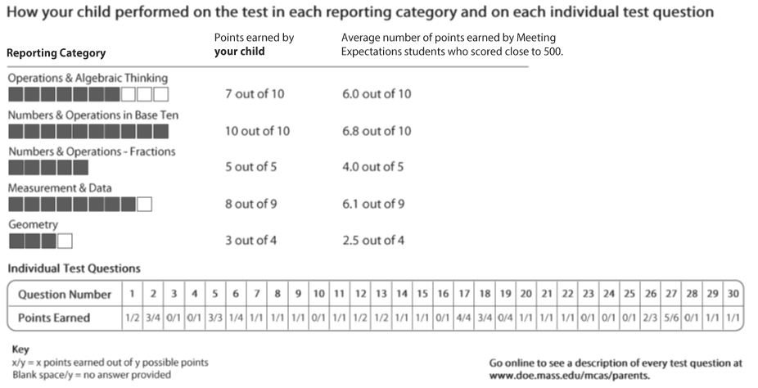

Slide 11
Why Did My Child Score Proficient on the Older MCAS but Only Partially Meeting Expectations This Year?
In general, the new standards for Meeting Expectations are more rigorous than the standards for reaching the Proficient level on the legacy MCAS.
Massachusetts educators set the new standards to help signal students’ readiness for the next grade level.
Look closely at where your child’s score falls within the Partially Meeting Expectations category. If it isn’t close to Meeting Expectations, talk with your child’s teacher about how you can work together to help your child catch up.
Spring 2017 is a baseline year for a new test in grades 3-8, and spring 2017 scores should not be compared to previous years’ scores.

Slide 12
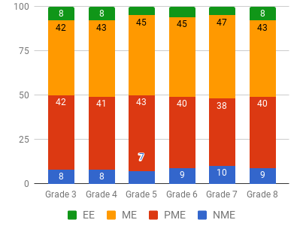
Projected Statewide 2017 Results for Grades 3-8 ELA and Math: Percent of students in each achievement level

Slide 13
Interpreting the Projected Results (Part 1)
The results do NOT mean that students learned less; the next-generation MCAS measures in a different way
Remember: 2017 is the baseline year — the first year of a new assessment — and we expect scores to change over time, as occurred when the legacy MCAS debuted in 1998.
Massachusetts educators set these standards, and they raised them in order to make sure our students will be college- and career- ready.
In some grades and subjects (grade 4 English language arts and math, grade 7 math), the percent of students Meeting Expectations will likely be similar to the percent that were Proficient previously. In other grades and subjects (grade 8 English language arts), the percent who are in Meeting Expectations will likely be lower than the previous percent of Proficient students.

Slide 14
Interpreting the Projected Results (Part 2)
The roughly equivalent proportion of students in each grade and subject area reflect:
  A standard setting process involving panels of educators who valued a clear progression of learning expectations from grade to grade;
  Panelists’ consistent application of the standards as they made expert judgments about student achievement on the new tests;
  The fact that standards were set for all these tests at the same time, unlike with the legacy MCAS

Slide 15
Projected Next-Gen MCAS Results Look More Like Massachusetts’s 2015 NAEP Results…
50%
46%
51%
54%
#1 in the nation
Tied for 1st
Tied for 1st
Tied for 1st
NAEP Levels
Notes:
Going into the standard setting, we did have a couple of things in mind. One of the other goals set forth by our new standards and this Board was to look to national and international benchmarks during the development of our next-generation tests. MA continues to be first, or tied for first, in the latest administration of NAEP in 2015. But notice that about half of MA students are still not reaching the Proficient level. Nationally, only about a third of students reach the Prof level.
While we did not intend to replicate the NAEP results, we did use it as a lens – this nationally respected test.

Slide 16
…and Less Like Legacy MCAS Results (2015)

Slide 17
Looking Beyond Scores
Scores can identify areas where students need academic support, but scores can also reflect non-academic barriers to learning.
ESE and districts continue to work together to:
  teach with poverty in mind,
  build cultural competency,
  address disproportionate and excessive student suspensions,
  support homeless students, and
  make schools safe for vulnerable students, such as LGBTQ students, recent immigrants, and others.

Slide 18
Accountability & the Next-Generation MCAS
Because of the new assessment, there will not be any new grades K-8 Level 4 schools this year.
Student growth percentiles, which measure how much progress a student made in a year, can still be compared across years.

Slide 19
How Do I Learn More?
MCAS Parents Page http://www.doe.mass.edu/mcas/parents/
  Resources coming soon include:
    Annotated Parent/Guardian Report
    Frequently Asked Questions (FAQs)
    Item Descriptions
MCAS Parent Guide (available in several languages): http://www.doe.mass.edu/commissioner/Back-to-School/

Slide 20
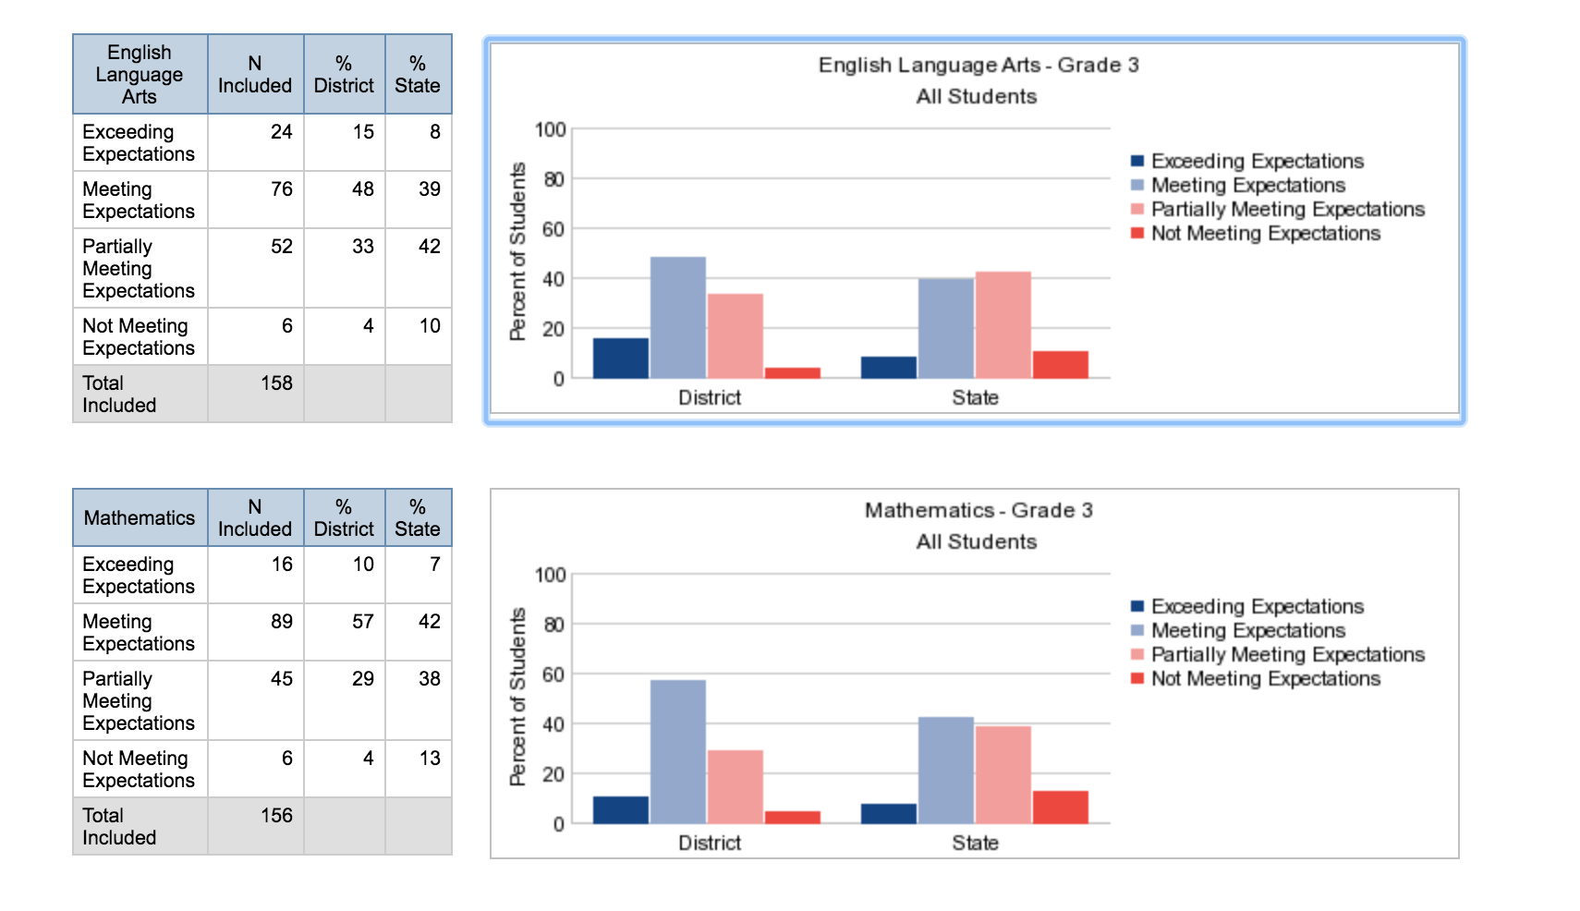
Grade 3

Slide 21
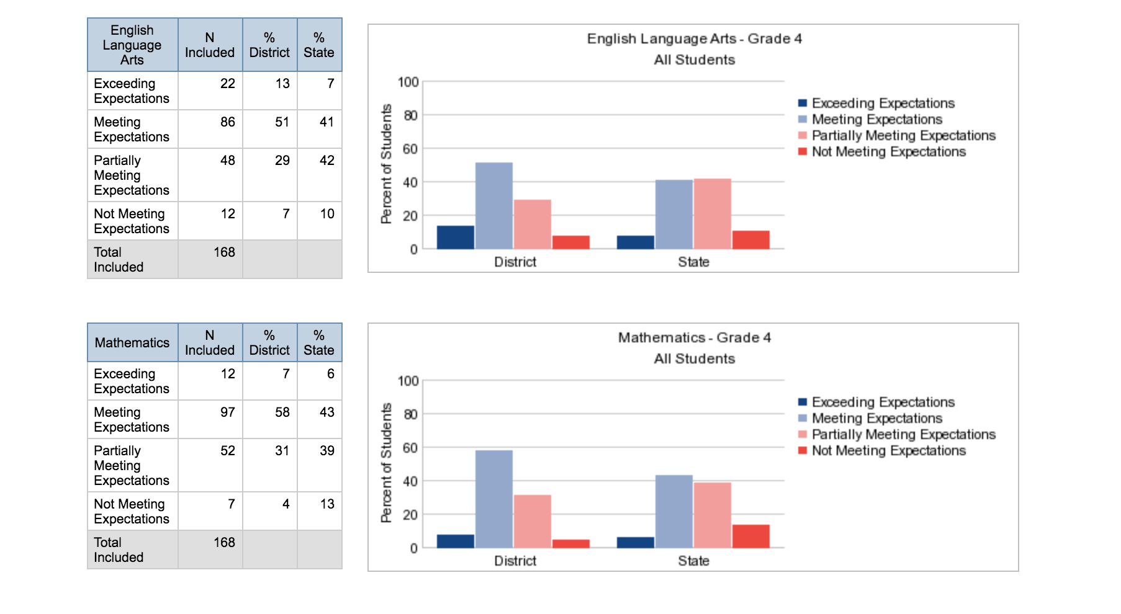
Grade 4

Slide 22
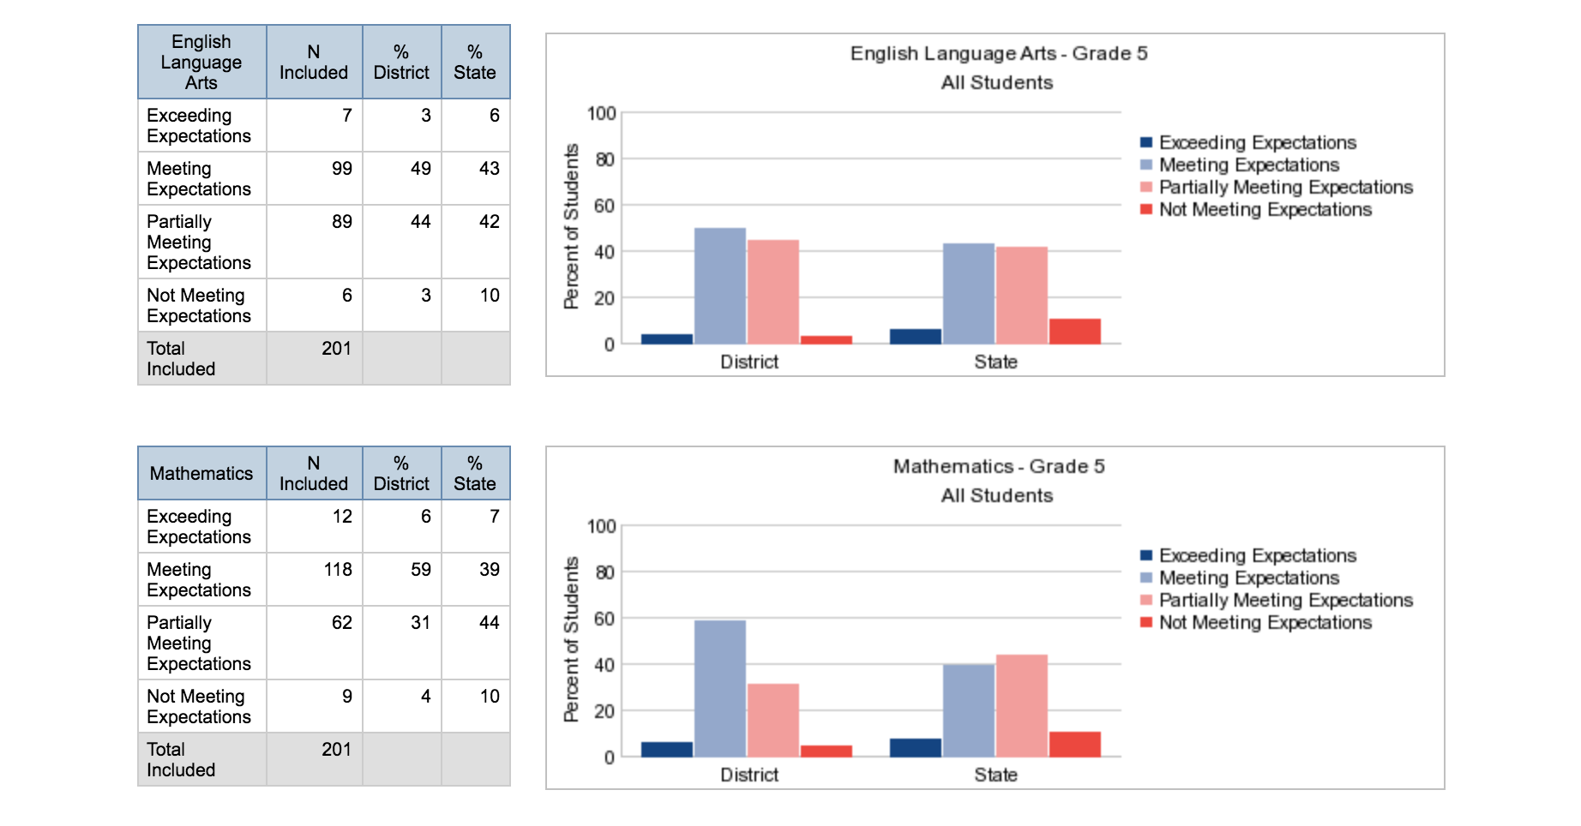
Grade 5

Slide 23
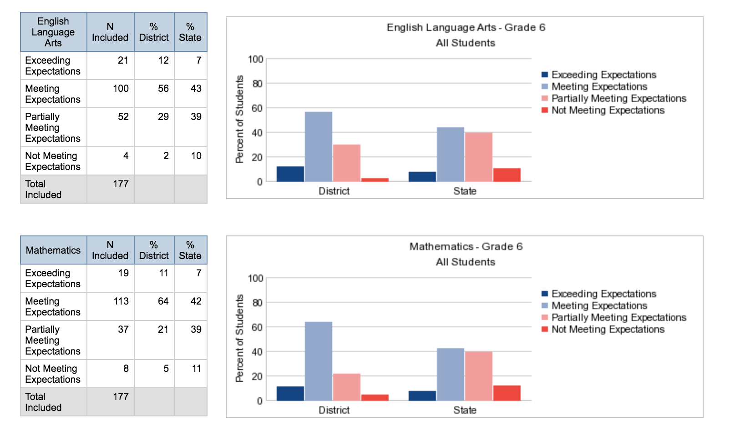
Grade 6

Slide 24
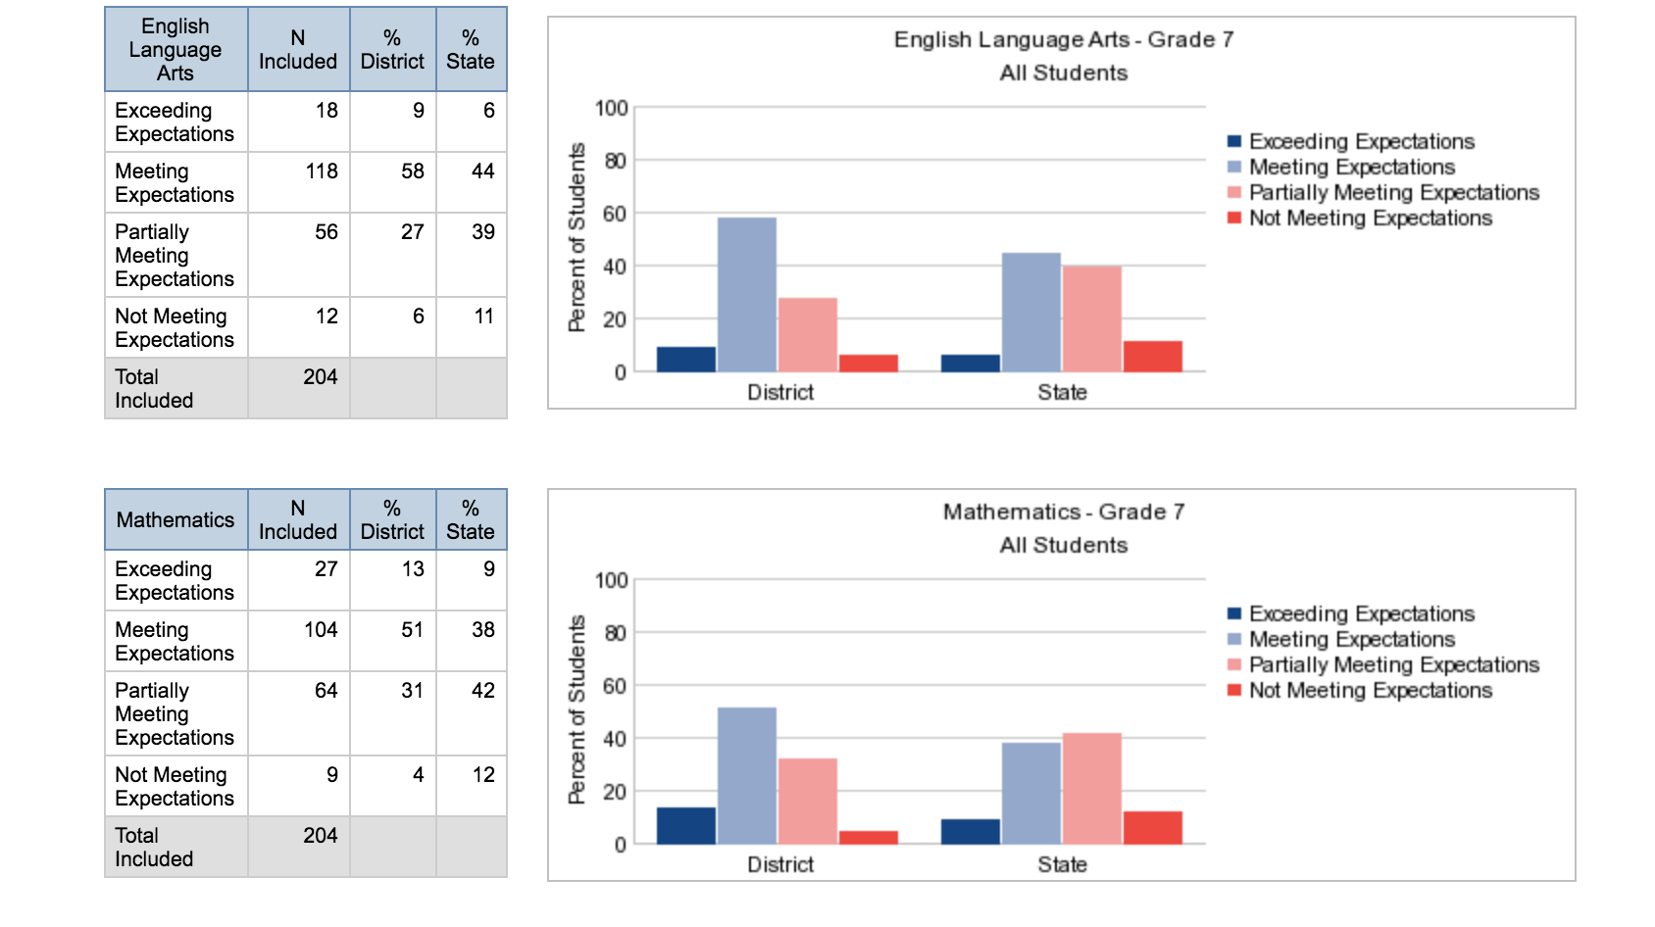
Grade 7

Slide 25
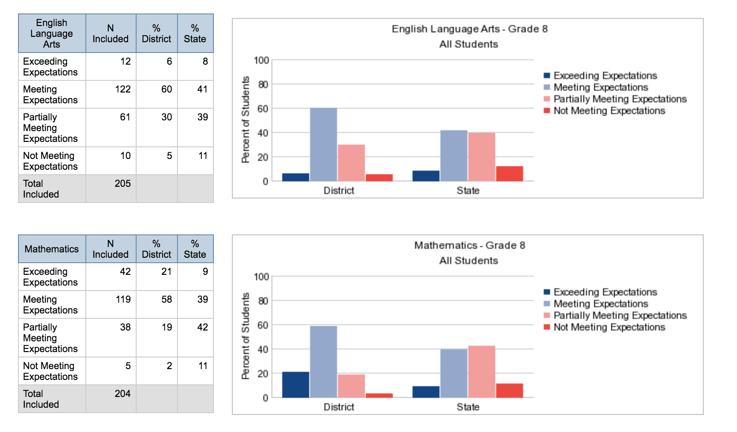
Grade 8

